Slide 1
Introduction
In the modern digital economy, streaming platforms compete intensely to acquire and retain subscribers, as user engagement, content consumption, and subscription continuity directly drive business sustainability. Netflix represents one of the most prominent examples of a platform where customer churn—i.e., users cancelling or discontinuing their subscription—poses a critical business concern. Churn is influenced by a complex interplay of behavioral, experiential, and contextual factors such as declining engagement, unsatisfactory recommendations, competing platforms, and changing preferences. Understanding not just who churns but why they churn enables proactive intervention strategies that safeguard revenue and user loyalty. This project leverages advanced data preprocessing, machine learning, and clustering techniques to build a predictive and explainable churn analytics framework capable of identifying at-risk users, uncovering behavioral patterns, and recommending retention strategies tailored to user segments.

Slide 2
Problem Statement
Customer churn results in significant revenue loss, reduced user base, and long-term decline in platform growth.
User disengagement and dissatisfaction are difficult to detect early, because behavior patterns vary across users.
Existing churn approaches are reactive, identifying users only after long inactivity or subscription cancellation.
Behavioral signals are scattered across multiple data sources (watch history, ratings, recommendations, searches), making churn prediction challenging.
Lack of targeted segmentation leads to generic retention strategies, which fail to address high-value customers at risk.

Slide 3
Objectives
To preprocess and clean multi-source user data to ensure accuracy, consistency, and readiness for analysis.
To explore behavioral and engagement patterns through descriptive analytics and churn-related indicators.
To engineer meaningful features capturing user recency, satisfaction, device usage, and content preferences.
To segment users using clustering techniques to identify groups with different levels of churn risk.
To build machine learning models that accurately predict churn and identify at-risk subscribers before they leave.

Slide 4
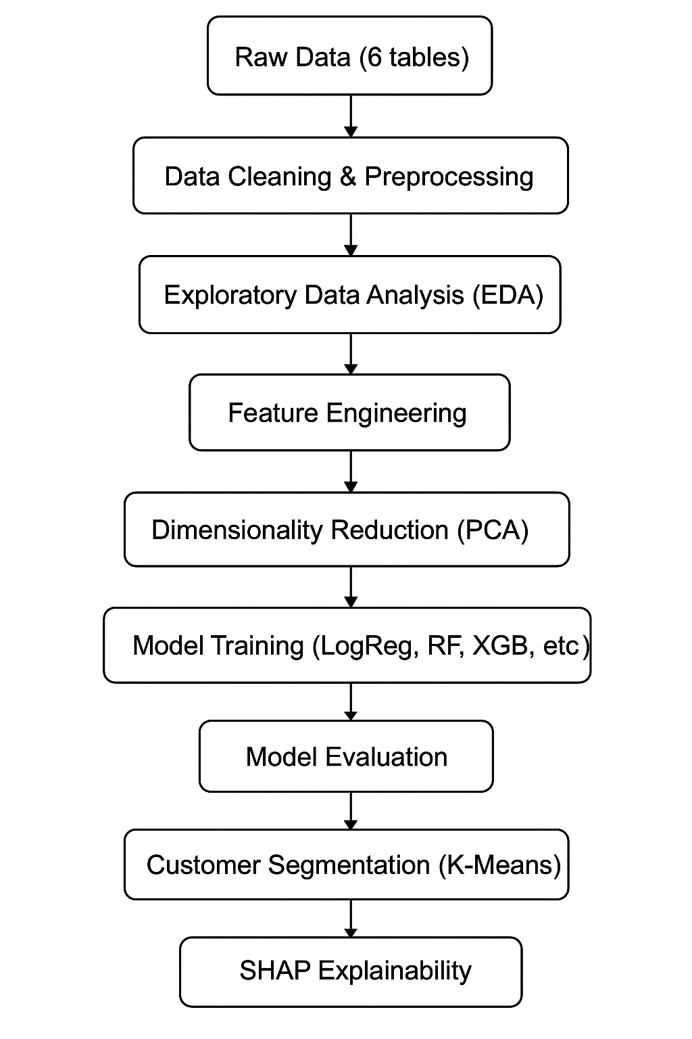
Design

Slide 5
Modules
Module 1 – Data Acquisition & Understanding
Integrate 6 data sources: Users, Watch History, Movies, Reviews, Recommendation Logs, Search Logs
Collect 10,000 unique user profiles from 210,000+ records
Understand attributes: demographics, plan type, content metadata, engagement metrics, sentiment
Identify target variable: churn = inactivity for >60 days
Establish data schema for behavioral, preference, and temporal features
Module 2 – Data Preprocessing & Feature Engineering
Handle missing data: median for numeric, mode/“Unknown” for categorical
Correct datatype mismatches across watch-time, timestamps, and rating fields
Apply one-hot encoding to categorical features like genre, plan type, and device
Engineer behavior metrics: total watch time, avg session duration, genre diversity
Generate recency features: days since last activity, week indicators
Detect and cap outliers using IQR method to control skewness

Slide 6
Modules
Module 3 – Exploratory Analysis & Clustering
Perform univariate and bivariate exploration to detect churn patterns
Analyze distribution of usage, engagement, plan tier, and satisfaction scores
Identify key churn indicators: inactivity, low engagement, negative ratings
Apply K-Means clustering on PCA-transformed data
Segment users into: Engaged Users vs High-Value Power Users
Generate churn–CLV risk map to prioritize revenue-critical segments
Module 4 – Model Building (Baseline & Ensemble)
Train Logistic Regression as baseline for interpretability
Train Decision Tree & Random Forest for non-linear patterns
Apply advanced boosting: XGBoost and LightGBM
Split data into 80% training / 20% testing
Address class imbalance using upsampling & class weights
Select LightGBM as final model due to best recall & PR-AUC

Slide 7
Modules
Module 5 – Model Evaluation & Explainability
Evaluate using Recall, Precision, F1-Score, ROC-AUC, PR-AUC
Compare baseline vs ensemble models
Use SHAP explainability to interpret churn drivers
Identify feature importance: inactivity, engagement decay, dissatisfaction
Generate user-level explanations for targeted retention
Link predictive results to business strategy and CLV

Slide 8
Implementation Details
Dataset Integration:
Combined six sources: Users, Watch History, Movies, Reviews, Recommendation Logs, Search Logs.
Linked using user_id and movie_id to form a unified customer-level dataset.
Final curated dataset: 10,000 users, 37 features.
Data Cleaning & Preparation
Numeric missing values filled using median; categorical missing values → mode or “Unknown”.
Outliers detected using IQR and capped for variables such as watch time and session counts.
Standardized data types and validated feature ranges.
Feature Engineering
Created behavioral metrics: total watch hours, average session duration, engagement frequency.
Temporal features: days since last activity, month, weekend indicator.
Satisfaction indicators: rating ratios, sentiment from reviews.
One-hot encoded categorical variables to prepare for ML.

Slide 9
Implementation Details
Dimensionality Reduction
Applied PCA to reduce high-dimensional encoded vectors.
Retained 95% variance, improving computational speed and model performance.
Model Development
Dataset split: 80% training / 20% testing.
Managed severe churn imbalance using upsampling and class weights.
Trained multiple models: Logistic Regression, Decision Tree, Random Forest, Gradient Boosting, XGBoost, LightGBM.
Explainability & Interpretation
Used SHAP values to interpret feature importance at both global and user level.
Identified key churn drivers: inactivity, declining engagement, negative ratings, low recommendation interaction.
Integrated insights with CLV–churn matrix for business-driven prioritization.

Slide 10
Methodology
The methodology begins with integrating six different datasets into a single user-level profile and performing extensive preprocessing, including missing value imputation, datatype corrections, and outlier handling. Behavioral and temporal features such as watch time, session frequency, recency, sentiment, and genre diversity were engineered to capture user engagement patterns. Exploratory Data Analysis was used to identify churn indicators, after which PCA was applied to reduce dimensionality. K-Means clustering helped segment users into meaningful groups based on behavior. Finally, multiple machine learning models were trained, compared, and interpreted using SHAP to identify the key drivers of churn and support actionable insights.

Slide 11
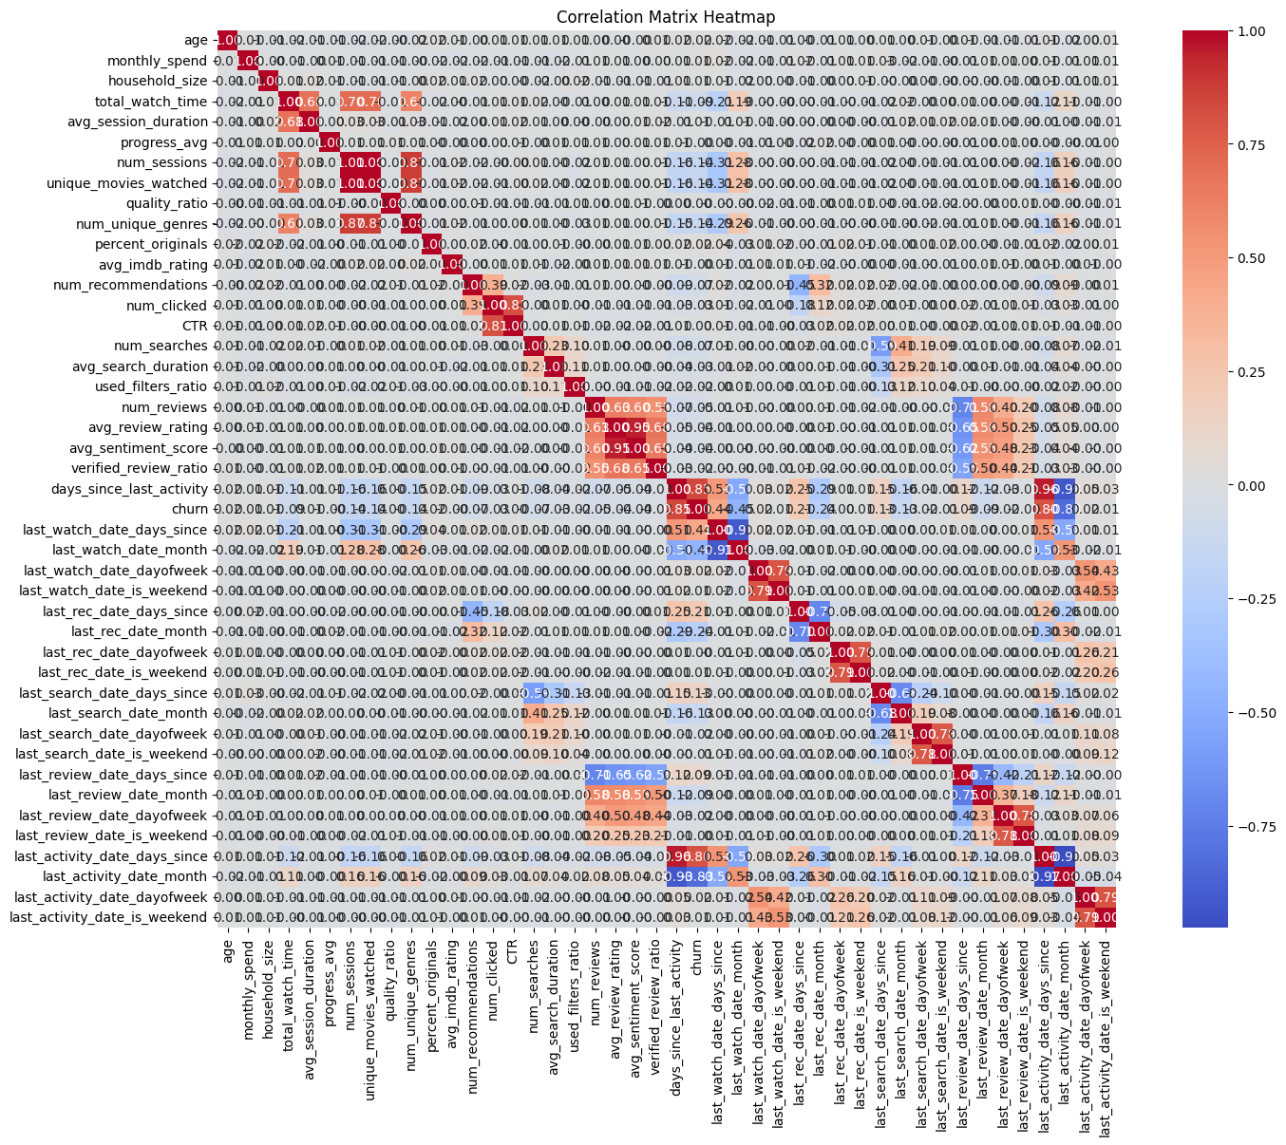
Results

Slide 12
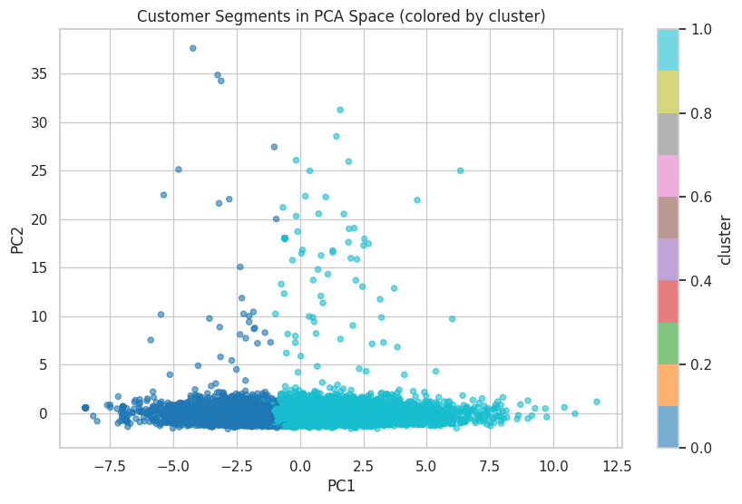
Results

Slide 13
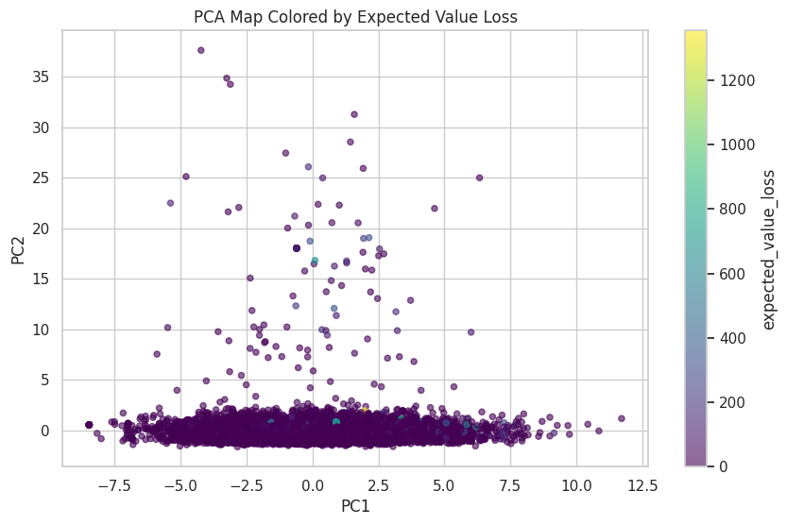
Results

Slide 14
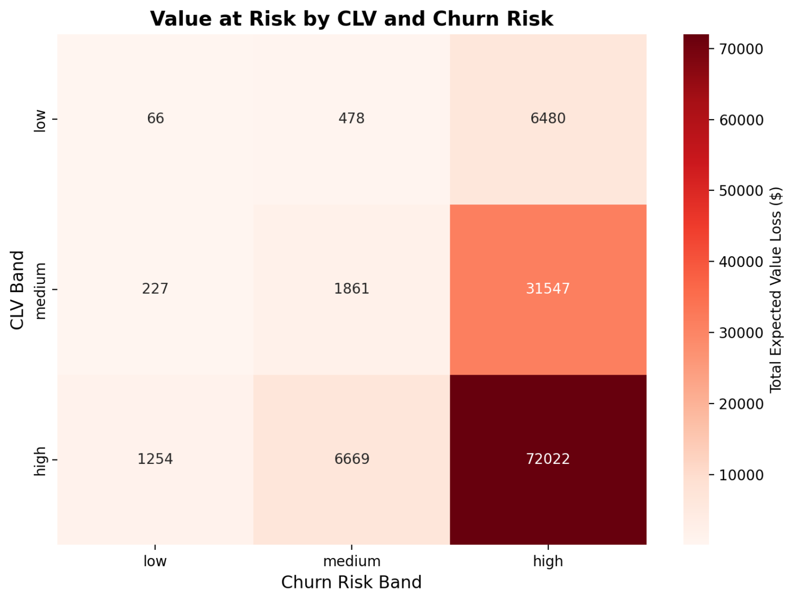
Results

Slide 15
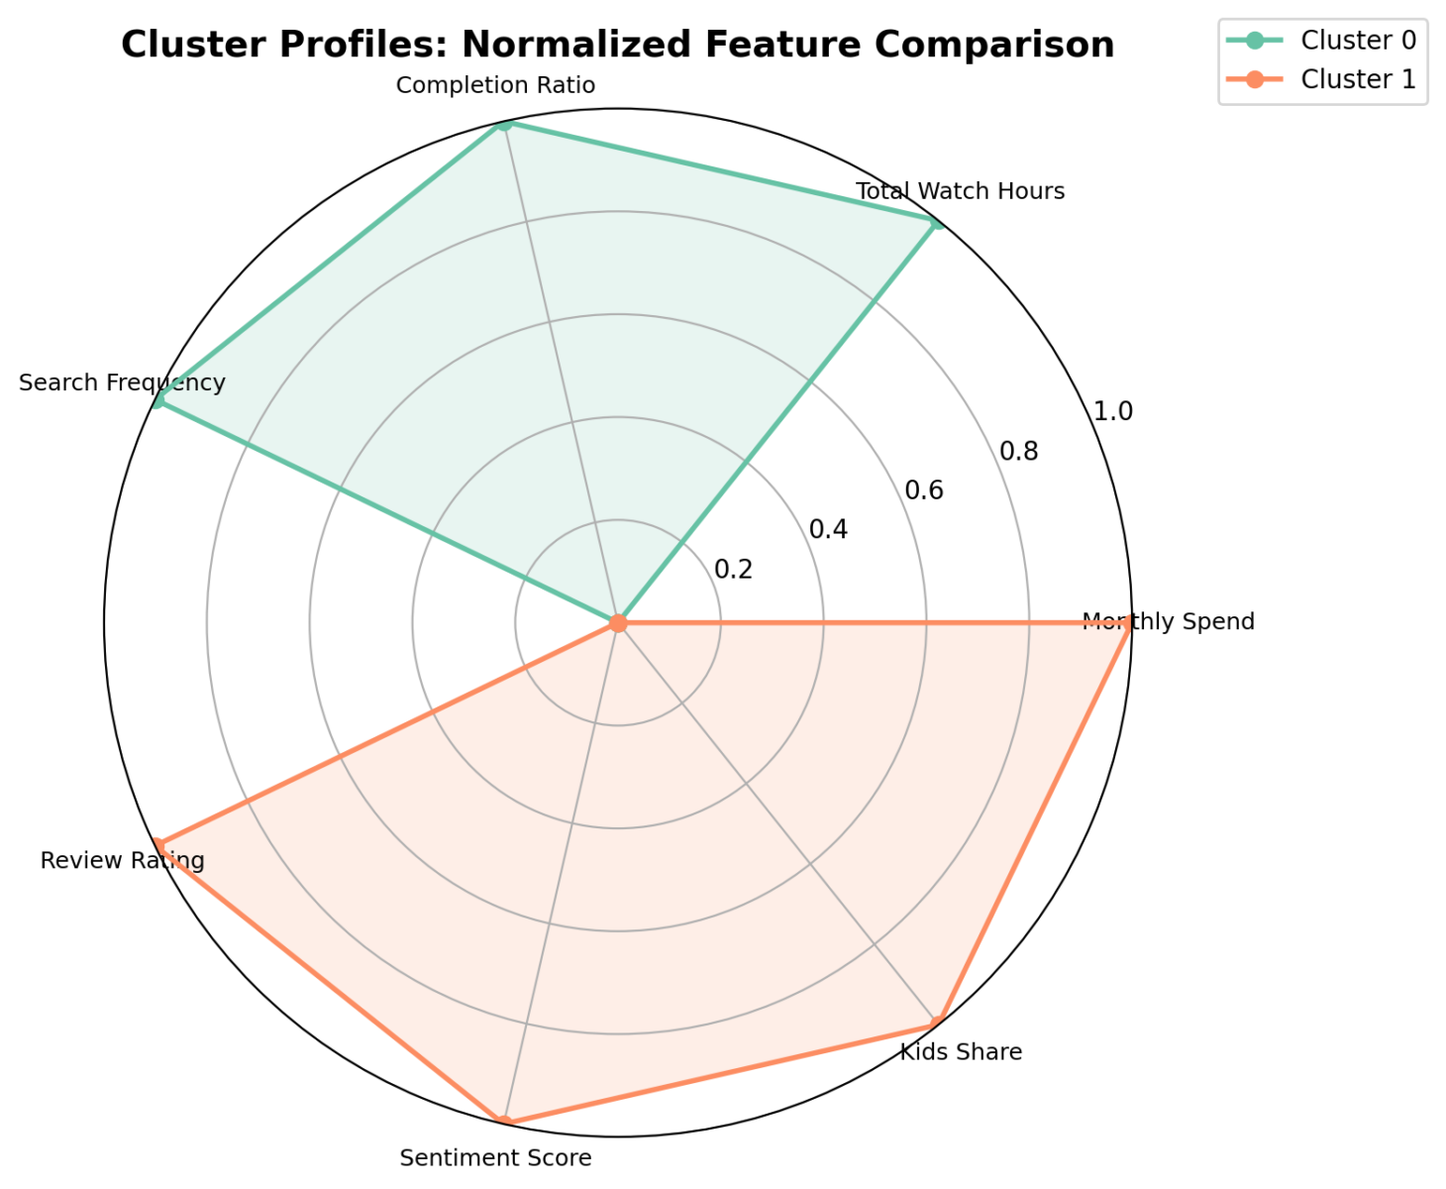
Results

Slide 16
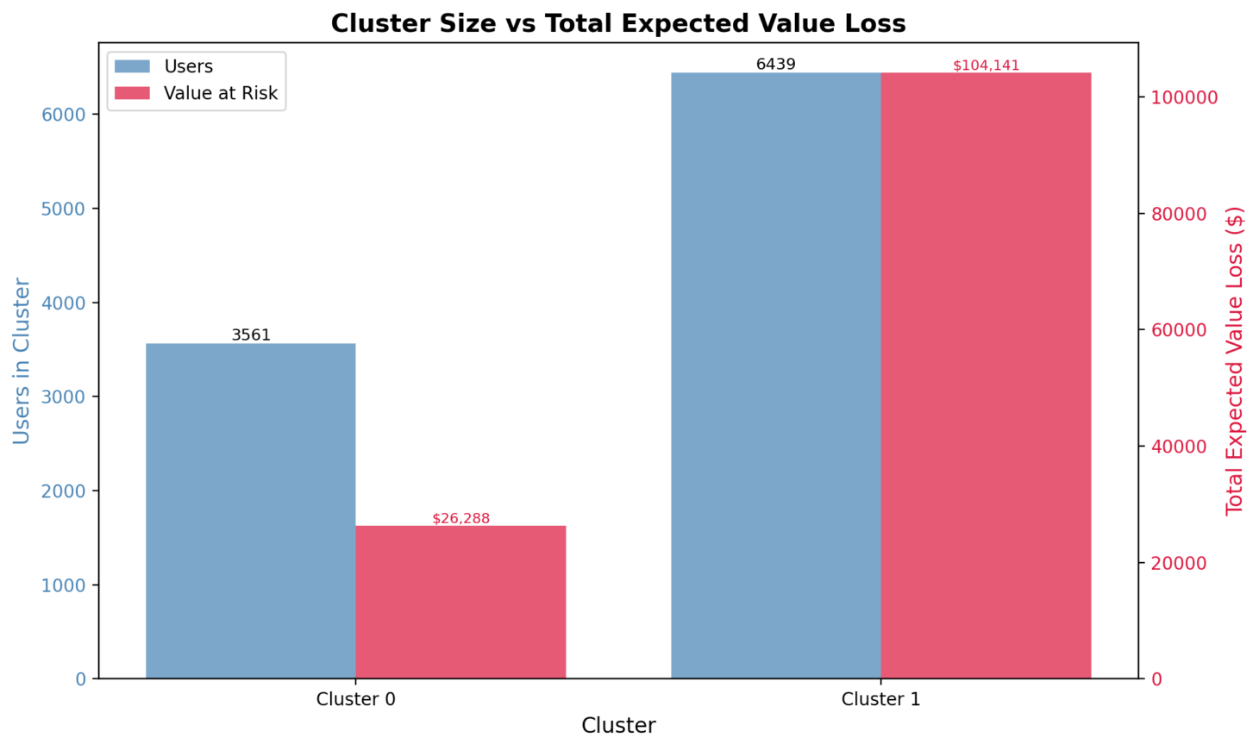
Results

Slide 17
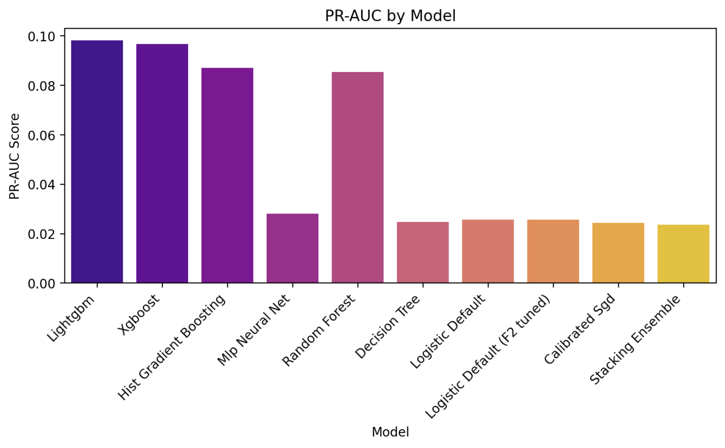
Results

Slide 18
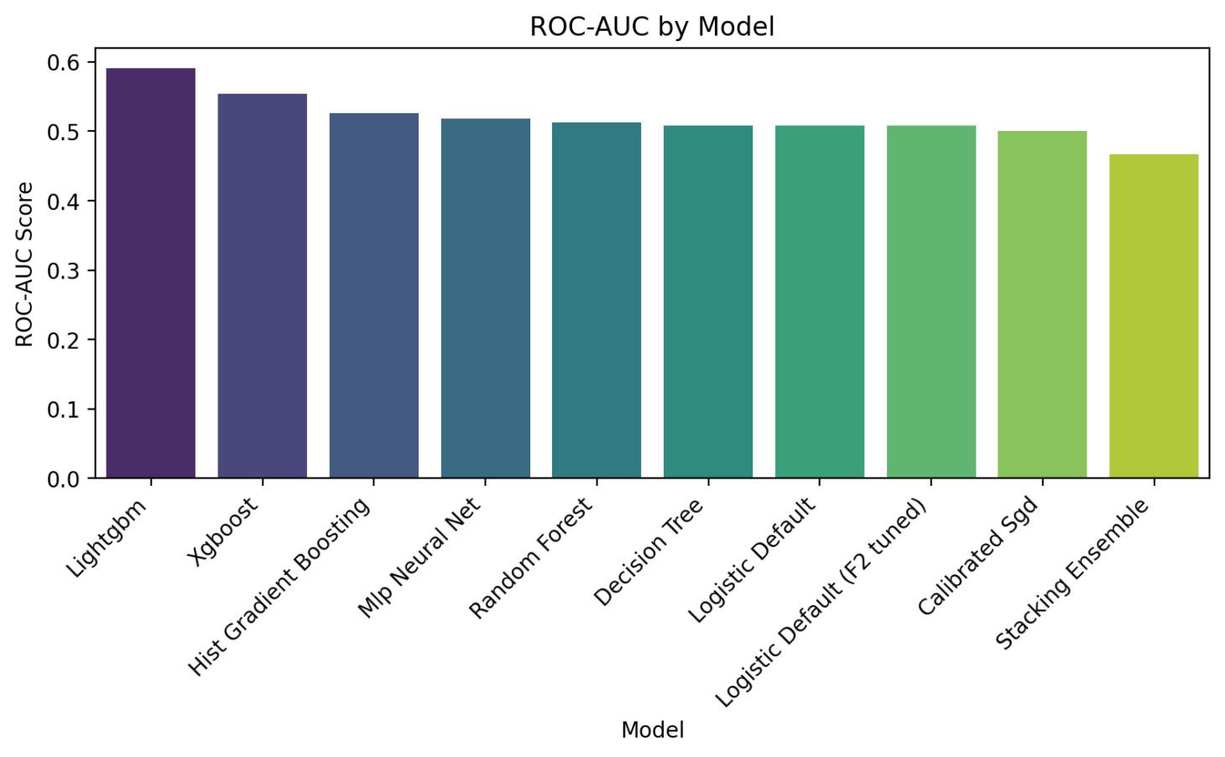
Results

Slide 19
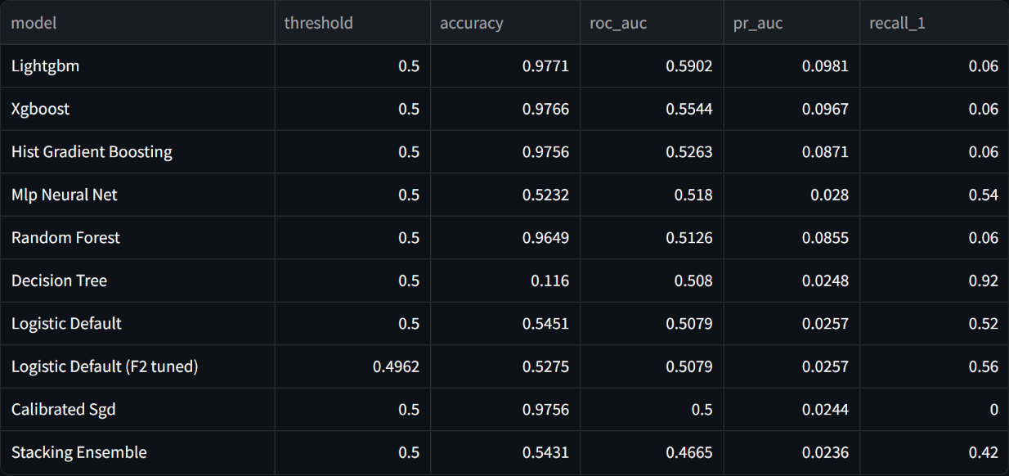
Results

Slide 20
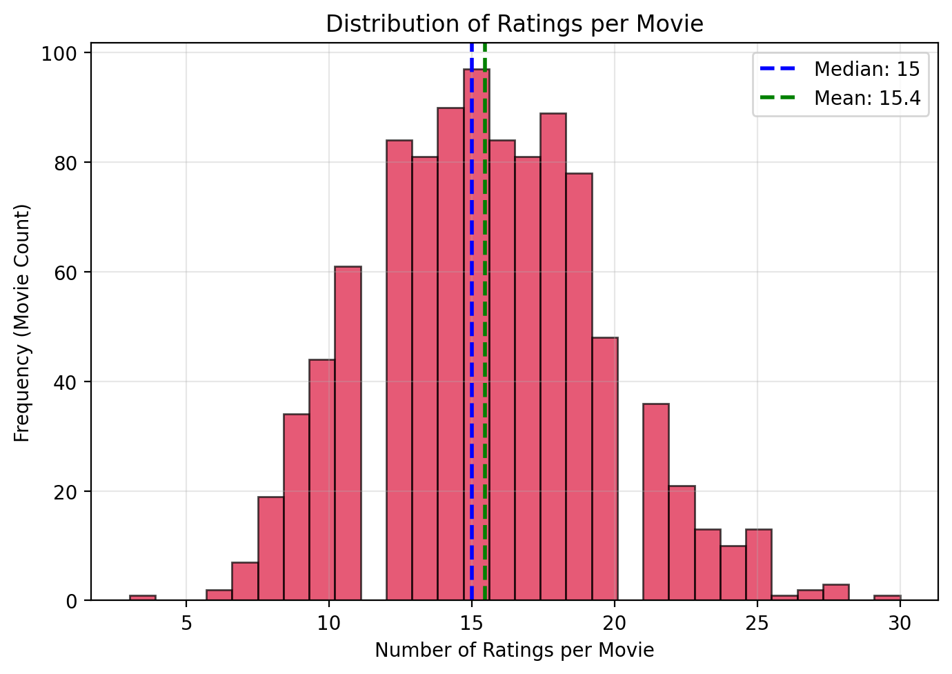
Results

Slide 21
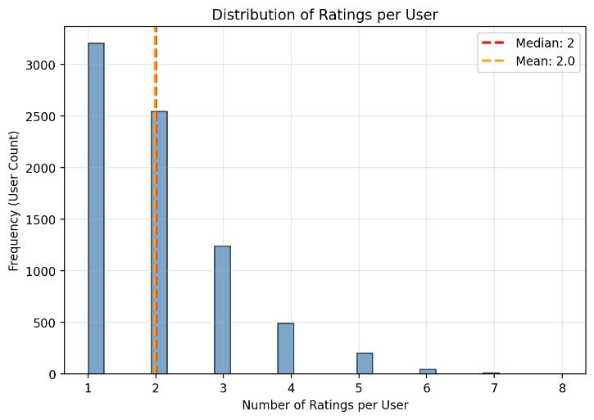
Results

Slide 22
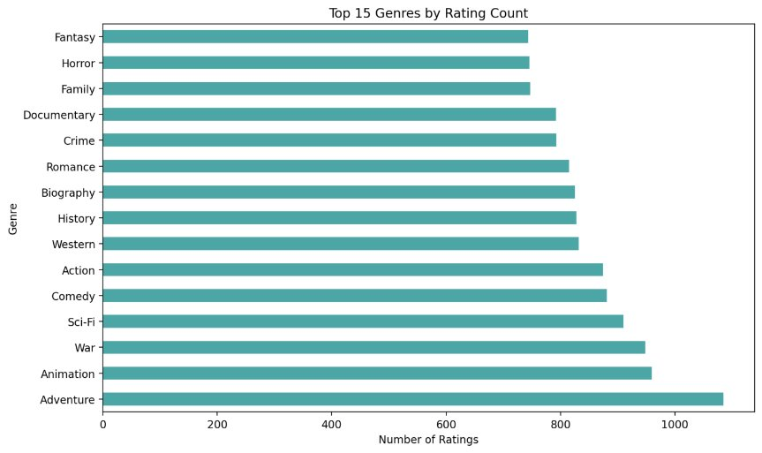
Results

Slide 23
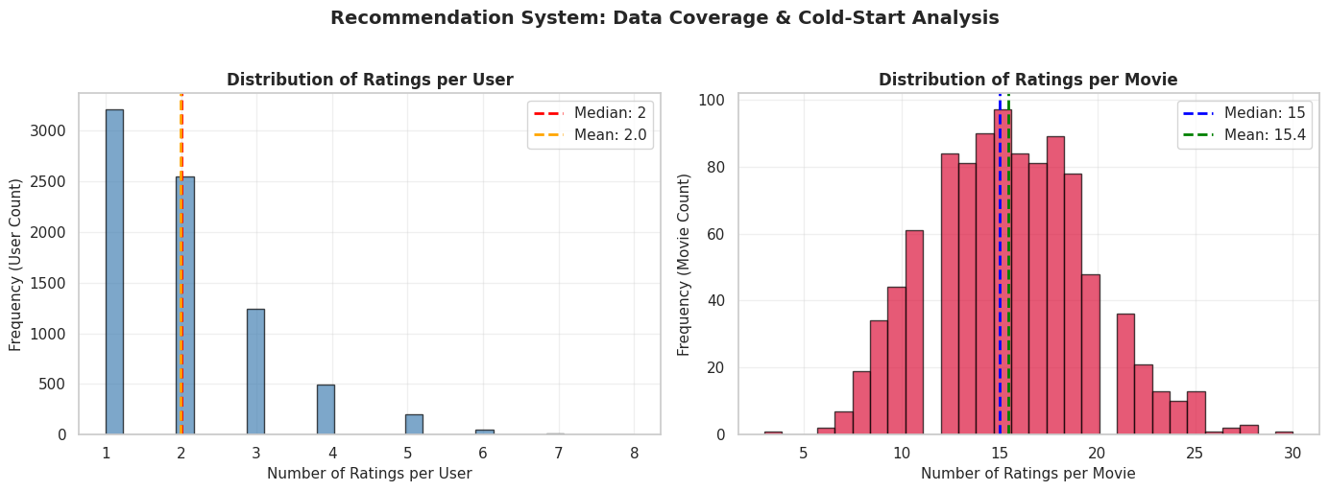
Results

Slide 24
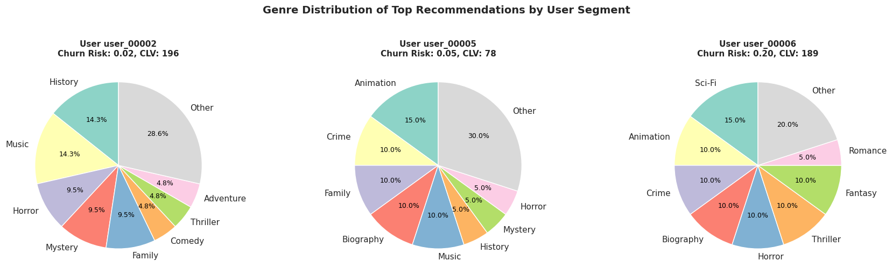
Results

Slide 25
Conclusion and Future scope
This project successfully developed a comprehensive churn prediction framework by integrating multi-source user data, engineering meaningful behavioral features, applying clustering for segmentation, and using ensemble machine learning models to identify at-risk users with high accuracy. The analysis revealed that declining engagement, long periods of inactivity, negative interactions, and low recommendation acceptance are strong indicators of churn, while higher-tier and consistently active users are less likely to leave. The final LightGBM model provided superior performance, and SHAP explainability helped uncover actionable insights that can support targeted retention strategies. Looking ahead, the system can be enhanced by incorporating real-time session analytics, integrating recommendation feedback loops, adopting reinforcement learning for personalized retention, and performing A/B-tested interventions to continuously refine business outcomes and user satisfaction.

Slide 26
References
[1] B. Prabadevi, R. Shalini, and B. Kavitha, “Customer churning analysis using
machine learning algorithms,” International Journal of Intelligent Networks, vol. 4,
pp. 145–154, 2023. [Online]. Available: https://www.sciencedirect.com/science/
article/pii/S2666603023000143
[2] A. Bhatnagar and S. Srivastava, “Customer churn prediction: A machine
learning approach with data balancing for telecom industry,” International
Journal of Computing, vol. 24, no. 1, pp. 9–18, Mar. 2025. [Online]. Available:
https://computingonline.net/computing/article/view/3873
[3] A. Manzoor, M. Atif Qureshi, E. Kidney, and L. Longo, “A review on machine learning
methods for customer churn prediction and recommendations for business practition-
ers,” IEEE Access, vol. 12, pp. 70 434–70 463, 2024.
[4] J. Y. Park, Y. T. Prasetyo, M. M. L. Cahigas, and R. Nadlifatin, “A conjoint-based
approach on determining the factors affecting on preference of subscribing a netflix
plan,” in 2024 IEEE International Conference on Industrial Engineering and Engi-
neering Management (IEEM), 2024, pp. 918–921.
15

Slide 27
References
[5] S. Tanuwijaya, A. Alamsyah, and M. Ariyanti, “Mobile customer behaviour predictive
analysis for targeting netflix potential customer,” in 2021 9th International Confer-
ence on Information and Communication Technology (ICoICT), 2021, pp. 348–352.
[6] L. Butgereit, “Work towards using micro-services to build a data pipeline for machine
learning applications: A case study in predicting customer churn,” in 2020 Interna-
tional Conference on Innovative Trends in Communication and Computer Engineering
(ITCE), 2020, pp. 87–91.
[7] O. Rezaeian, S. S. Haghighi, and J. Shahrabi, “Customer churn prediction using data
mining techniques for an iranian payment application,” in 2021 12th International
Conference on Information and Knowledge Technology (IKT), 2021, pp. 134–138.
[8] L. Ou, “Customer churn prediction based on interpretable machine learning algo-
rithms in telecom industry,” in 2023 International Conference on Computer Simula-
tion and Modeling, Information Security (CSMIS), 2023, pp. 644–647.
[9] Asniar and K. Surendro, “Predictive analytics for predicting customer behavior,” in
2019 International Conference of Artificial Intelligence and Information Technology
(ICAIIT), 2019, pp. 230–233

Slide 28
THANK YOU

